Slide 1

STUDENT PERFORMANCE PREDICTION USING DATA MINING
ASHISH PAUL STEPHEN (805663515)
MOHIT KIRANGE (805600418)
CPSC-531-02 Advance Database Management
PROFESSOR: DR. CHUN-I P.CHEN

Slide 2
PROBLEM DEFINITION
At present, most of the institutions or organization in India are facing the problem of student admission rate.
Reasons for that like less placement record, less infrastructures, syllabus not updated, less qualified staff, poor teaching methodology.
Without providing these features no college will sustain soon and face the problem of failure.
To remain in the competition with other college they need to provide extra to the student which helps them to improve their graduation rates and overall education system.

Slide 3
PROBLEM DEFINITION
With the help of analysis, we can predict the result of the student, dropout of any student, placement of the student, behavior of the student etc.
If any student having a risk of failure and we can predict that risk in advance, then we can provide timely help to that student. There are lots of data mining techniques which are applied on educational data like classification and clustering

Slide 4
FACTS
A study by the National Assessment and Accreditation Council showed that 90 % of the colleges and 70 % of the universities that the council graded were of middling or poor quality in India.
India has one of the lowest higher education enrollment ratio of 11%. In the US it is 83 per cent.
While 347,985 students earned business degrees in past year, only 15,496 grads walked away with a degree in mathematics. I find that sad.
Nationwide the number of high school graduates is expected to grow 10 percent in the next 10 years.

Slide 5

PROJECT GOAL
To develop a model/system that had the capability of predicting the student’s success
Help universities for better plan for the anticipated number of students enrolling in their programs, predict the dropout ratio, easily identify weak students, and make better use of available resources ranging from the number of faculties to the utilization of other resources
to improve its learning process to better benefit students.

Slide 6

WHY DATA MINING FOR PREDICTION??
There are two forms of data analysis that can be used for extracting models describing important classes or to predict future data trends. These two forms are as follows −
Classification
Prediction
For example, we can build a classification model to categorize bank loan applications as either safe or risky, or a prediction model to predict the expenditures in dollars of potential customers on computer equipment given their income and occupation.

Slide 7

EDUCATIONAL DATA MINING (EDM)
It is an emerging discipline, concerned with developing methods for exploring the unique types of data that come from educational settings, and using those methods to better understand students, and the settings which they learn in.
Used to research and build models based on assumption of PATTERNS AND PREDICTION.
If we can discern the pattern in the data and make sense of what is going on, we can predict what should come next and take the appropriate action.

Slide 8
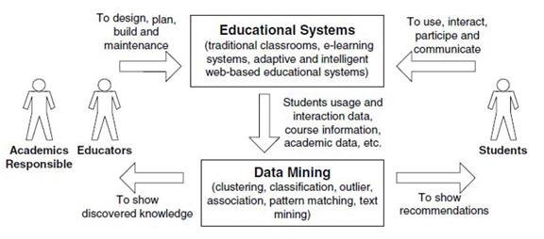
SYSTEM ARCHITECTURE
The cycle of EDM

Slide 9
DESIGN & FUNCTIONAL REQUIREMENTS
Data mining tool should able to accept any size of dataset as input
should be able to apply any type of classification technique efficiently irrespective of its size .
Its execution time should be minimum, this thereby enhances accuracy as well as efficiency. The tool should be able to visualize the output processed data in any graphical manner.
Training dataset of students details is required to develop the required model that defines logic for the prediction.
Test dataset is required for running the model in order to predict the possible grades.

Slide 10



SYSTEM & SOFTWARE REQUIREMENTS
Min System Requirements :
1.6 GHz processor, 2 GB of RAM , 10 GB of available hard disk space
Software used :
For loading dataset & connecting the model
For developing UI
in C# & HTML
For Preprocessing and building a model.

Slide 11
Waikato Environment for Knowledge Analysis (Weka)
Popular suite of machine learning software
Developed at the University of Waikato, New Zealand.
It is free software licensed
can be applied directly to a dataset or called from your own Java code.
tools for data pre-processing, visualization , classification, regression, clustering, association rules, and visualization
As EDM stresses on analysis and predict, same fashion is continued as Model is created based on analysis and this model is used for prediction.

Slide 12
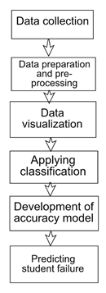
PROPOSED METHODOLOGY
Dataset is collected.
Dataset is uploaded to WEKA and accuracy is noted.
Model is created from WEKA after classification.
Model is saved along with the .csv data file.
Model is loaded into MYSQL along with the dataset.
Model is used to make prediction on test data.
Prediction is made using UI made via visual studio.

Slide 13

SOURCE OF DATA
From the Computer Science department at Mumbai University, India,
2 consecutive semesters, 2015-2016.
200 records for each course “Data Structures” and “Computer System and Organization”
Attributes : student ID, student name, student grades in quiz1, quiz2, and quiz3, midterm1, midterm2, project, tutorial, final exam, and total points.

Slide 14
DATASET USED
This is sample of the training data set that was used for the prediction.
Name | ID | Mid1 | Mid2 | Quiz 1 | Quiz 2 | Quiz 3 | Project | Tutorial | Final Lab | Final Exam | Total | Grade
Rahul | 121 | 9 | 10 | 3 | 4 | 4 | 8 | 2 | 5 | 39 | 84 | B
Karun | 122 | 10 | 9 | 2 | 5 | 5 | 9 | 5 | 9 | 40 | 94 | A
tapan | 123 | 1 | 1 | 5 | 1 | 1 | 8 | 1 | 10 | 34 | 62 | D
manan | 124 | 3 | 8 | 4 | 1 | 5 | 9 | 4 | 9 | 32 | 75 | C
samson | 125 | 4 | 7 | 5 | 3 | 4 | 9 | 5 | 6 | 39 | 82 | B
zeeban | 126 | 9 | 10 | 5 | 5 | 5 | 9 | 5 | 5 | 40 | 93 | A
yohan | 127 | 9 | 8 | 1 | 5 | 3 | 7 | 2 | 6 | 35 | 76 | C
loham | 128 | 8 | 1 | 5 | 3 | 5 | 9 | 4 | 6 | 37 | 78 | C
kamal | 129 | 5 | 1 | 1 | 2 | 4 | 9 | 4 | 9 | 33 | 68 | D
hector | 130 | 7 | 6 | 1 | 4 | 3 | 10 | 5 | 7 | 35 | 78 | C
june | 131 | 7 | 2 | 5 | 5 | 5 | 7 | 5 | 5 | 38 | 79 | C
john | 132 | 3 | 3 | 3 | 1 | 1 | 8 | 3 | 6 | 31 | 59 | F
tom | 133 | 9 | 9 | 5 | 5 | 5 | 9 | 5 | 9 | 36 | 92 | A
tim | 134 | 2 | 9 | 4 | 5 | 1 | 7 | 3 | 7 | 38 | 76 | C
ben | 135 | 8 | 2 | 3 | 3 | 5 | 10 | 2 | 7 | 32 | 72 | C
sarah | 136 | 9 | 10 | 3 | 3 | 5 | 9 | 3 | 9 | 39 | 90 | A
paul | 137 | 8 | 3 | 1 | 3 | 5 | 10 | 5 | 7 | 30 | 72 | C

Slide 15
PREPARATION AND PREPROCESSING
Eliminating the records of students who withdrew from the course
Relevant values were consequently missing.
Defining students performance into two categories as pass or fail.
Discretizing the total grade attribute into five categories: A, B, C, D, and F.
CLASSIFICATION
It predicts the class of an attribute based on the value Journal of other attributes
i.e. Classification is the process of placing an object into a class or category.
This process involves two primary steps:
Learning : A set of training data is analyzed to build a model with a predetermined set of classes.
Testing : A different set of data is tested to determine the accuracy of the model.

Slide 16
APPLIED CLASSIFICATION ALGORITHMS
C4.5 decision tree (J48 in WEKA)
A decision tree is a tree-like structure, Branch represent class and nodes represent attributes. Decision tree algorithms describe the relationship among attributes, and the relative importance of attributes.
Naïve Bayes
Bayesian classifiers are statistical classifiers that predict class membership by probabilities belongs to a class.
JRip rule-based algorithm
Basic and most popular algorithm. Classes are examined in growing size and an initial set of rules for the class is generated using incremental reduced error. Decision in the training data is a class, and finding a set of rules that cover all the members of that class.

Slide 17
TABLE OF ACCURACY
Algorithm | Correctly Classified Instances (Accuracy) | Incorrectly Classified Instances
Naïve Bayes Algorithm | 93.5% | 6.5%
JRip Algorithm | 99% | 1%
Decision Tree/ J48 | 98.5% | 1.5%
We make use of Decision Tree i.e J48 Algorithm to develop our model as we can
Visualize the logic tree which is implemented into website thereby enhancing understanding of the model.
We can develop a model in Mysql as well but Weka offers wide varieties of predefined
Algorithms that we can run on our dataset thereby obtaining accuracy for each algorithm
Used on the dataset thereby coming up with the best model possible.

Slide 18
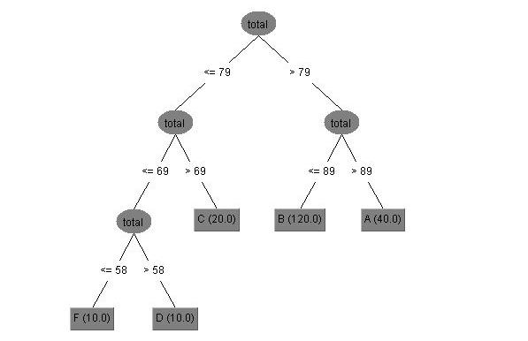
DECISION TREE EXTRACTED FROM WEKA

Slide 19

EXECUTION
We developed the website for the students performance prediction named as ‘FutureGrade’ which is built with help of Bootstrap and C# using tool Visual Studio.
Currently website introduces the EDM by Mumbai university and allows grade prediction for two subjects i.e. ‘Data Structure’ and ‘Computer Organization and architecture’
And also allows user to see the graphical representation of previously collected data for subjects.

Slide 20

Collection of user data
After clicking on the ‘know your grade’ new Subject page opens and user is asked to enter his available academic data into the form to predict his grades
Subject page also allows user to see details of subject as course objectives and outcomes.

Slide 21

Predicted grade - RESULTS
Based on user submitted data the website used the prediction logic which is implemented into the website to predict the possible grade. Hence by grade we can identify whether user is passed or failed.
The logic used is extracted unknown pattern identified by applying various classification algorithms in data mining on the training dataset with help of weka.

Slide 22
Future Scope
Use of data mining in education field is will continuously improve the overall education quality not only limited to India.
Academic responsible and educators will be able to introduce advanced lerning methods.
E-learning can be motivated, as the use of social networking tools like Blog and Facebook since these applications already gained high popularity among students and suitable to be used to engage the students with collaborative learning.
Reducing instructor intervention by supporting decision and recommendation systems.
Future possibility of Implementing new algorithms and machine learning systems to achieve better accuracy and less processing time.

Slide 23
CONCLUSION AND IMPLICATIONS
In this project, we analyzed students’ academic performance by predicting of possible grades i.e. to help improve the quality of the education imparted to them.
We tested the accuracies of Naïve Bayes, J48 and Jrip classification algorithms in which Jrip algorithm showed the most accuracy of 99%. Also used J48/ Decision tree algorithm to understand the logic/model.
We achieved the goal of our project i.e. to developed the model using data mining to predict the students grades by extracting the pattern from available training set. Hence we can predict the future problems and find solution on them.
We might, of course, encounter some problems, such as data collection and its processing as EDM field is still evolving.
We hope that this review will be able to shed some useful insights for researchers and educators in order for educational data mining to become a mature area.

Slide 24
Thank You

